Slide 1
Food Nutrition Detection
Patrick L. and Colin H.

Slide 2
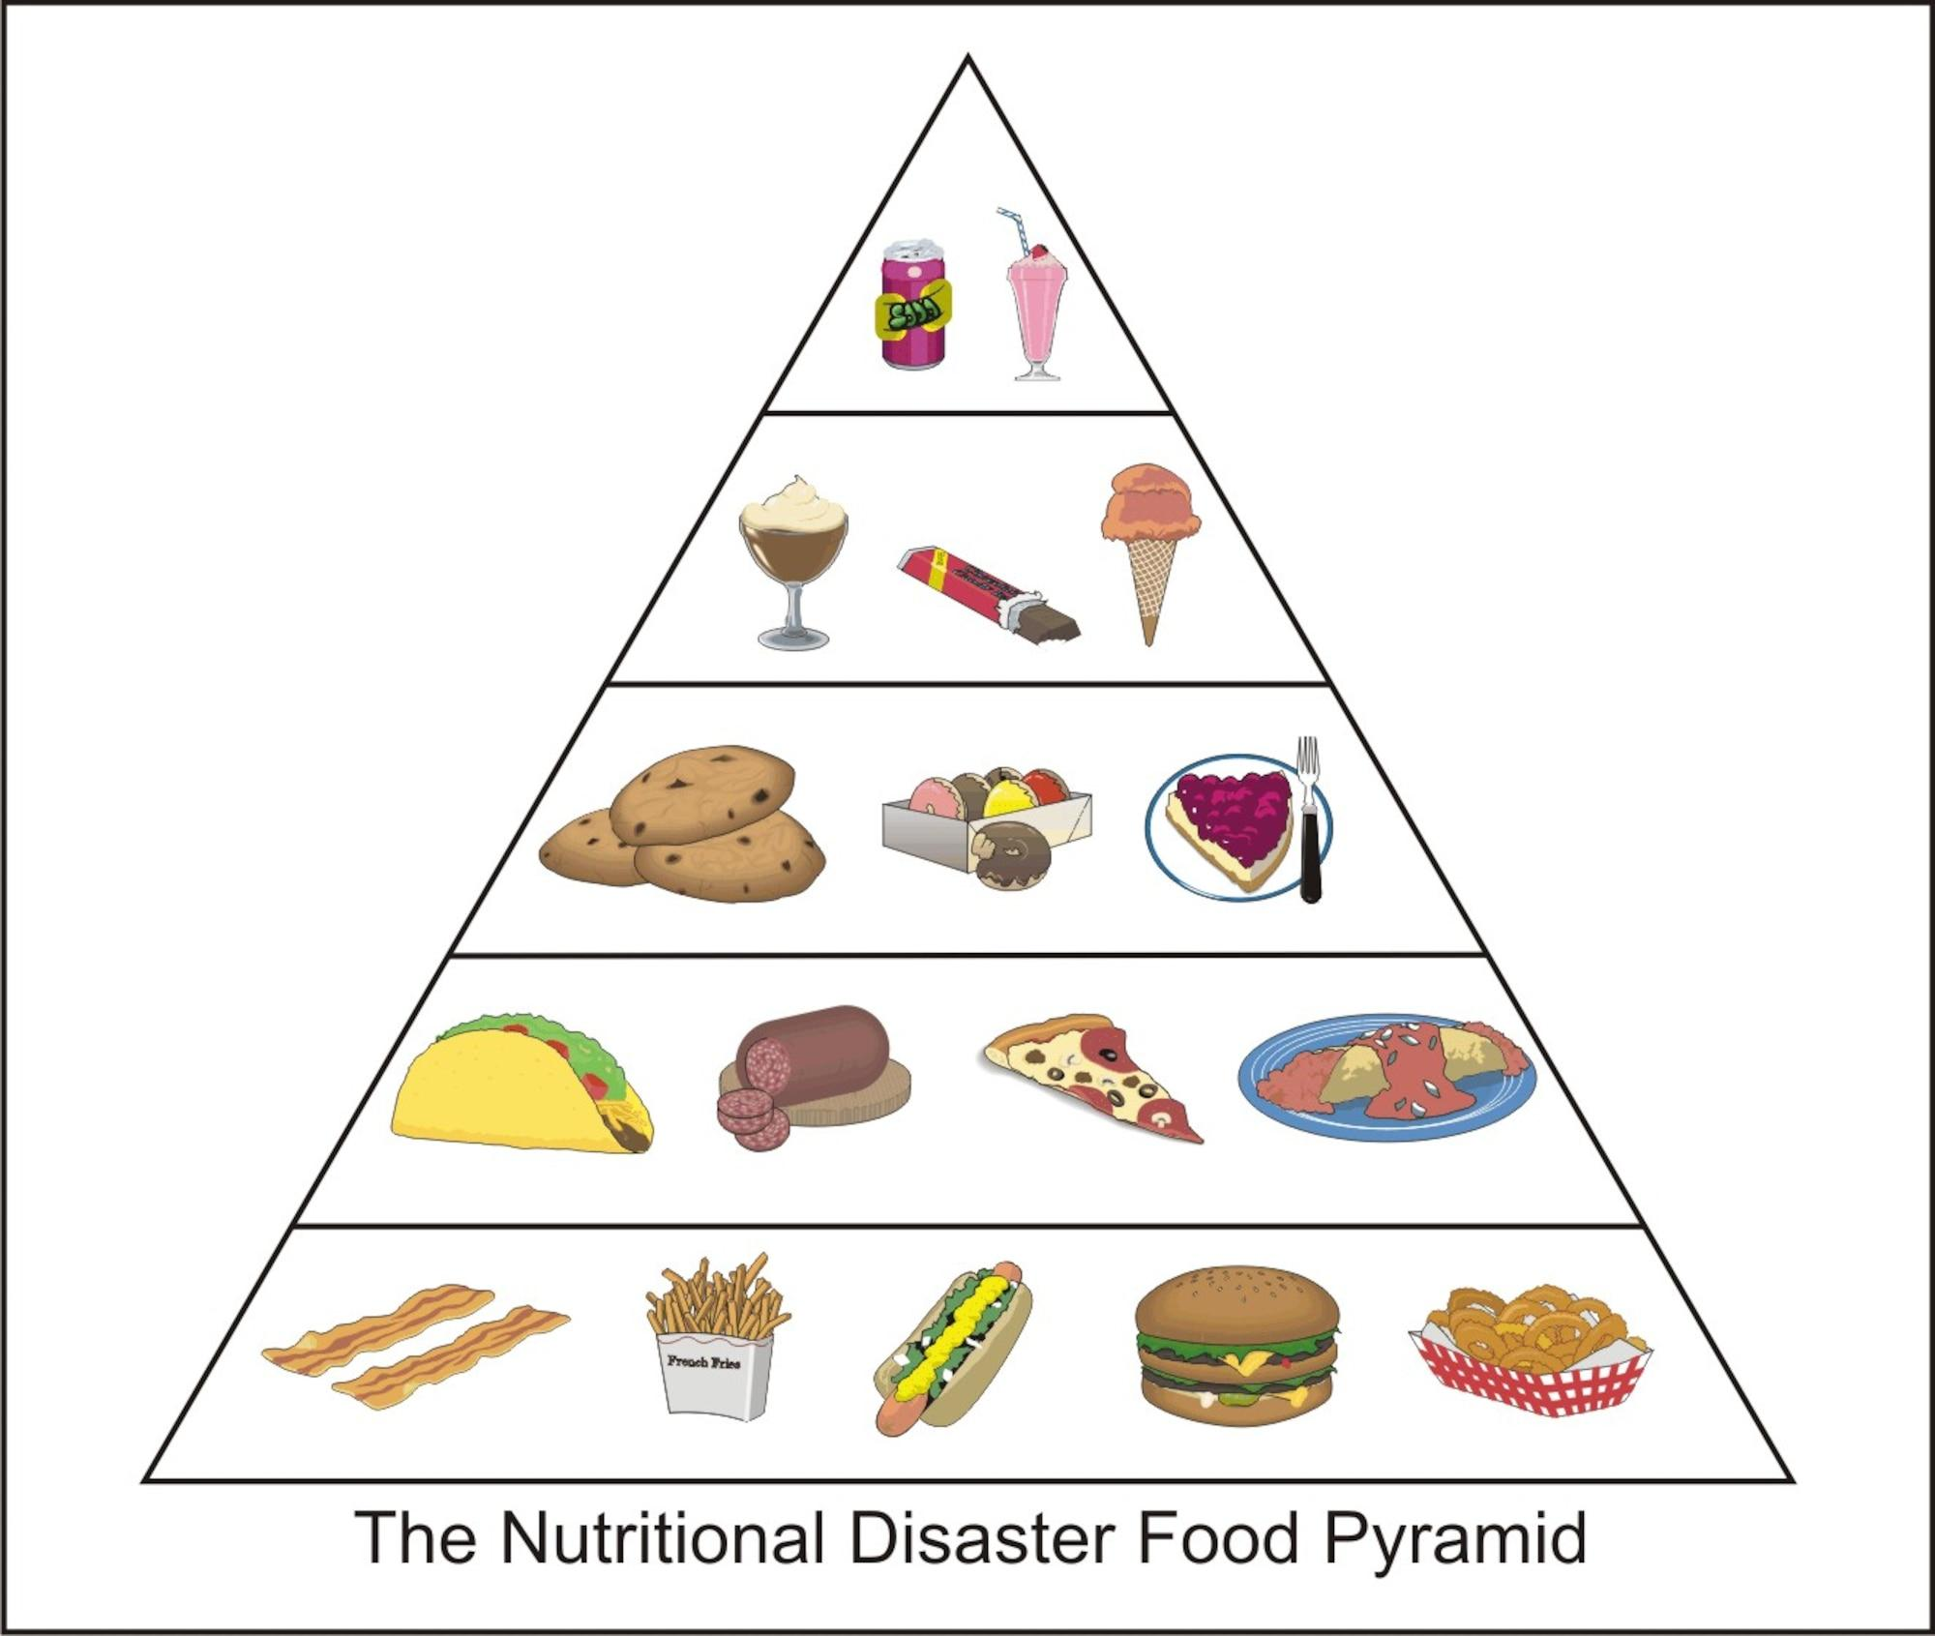
Importance of Nutrition
Knowing what you eat and how much of it is important
Obesity is high and can cause long term issues
Being able to easily learn the facts of your diet can help you eat healthier

Slide 3
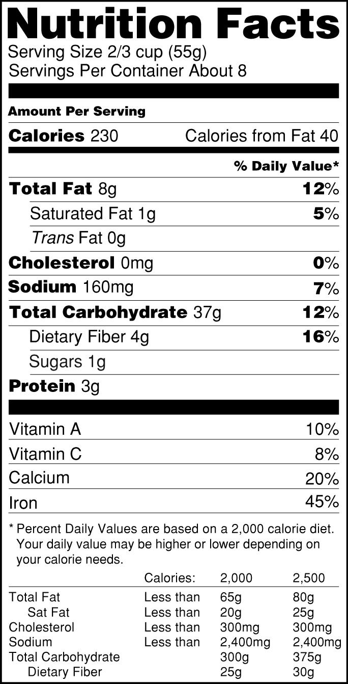
Purpose of this Project
We wanted to create a model that not only detected what the food was but also so people could see the nutritional facts of what they were eating.

Slide 4

How it Works
This model works by using the COCO database. It has a bunch of images that are built in so it is very useful for a good starting point.

Slide 5
Edits we Made to the Code
Raised the probability of the model to make it more accurate in detection
Format the text and added an image
Modified the way the code detected the images to check if it is food or not.
Added hyperlinks to the detected foods to allow users an opportunity to check the nutritional facts
Notes:
GOTO vs code to show what we just mentioned in last 2 slides

Slide 6
Live Demo
Notes:
Demo actual model

Slide 7
Questions?
Notes:
Check for questions

